Slide 1

Marko Javorac, Jacob Ladan, Denald Demirxhiu
https://github.com/roomi-develop/roomi

Slide 2

Scope
Schedule
Application Flow
Database Design
Application Demo
Testing
Acquired Knowledge
Future Plans

Slide 3
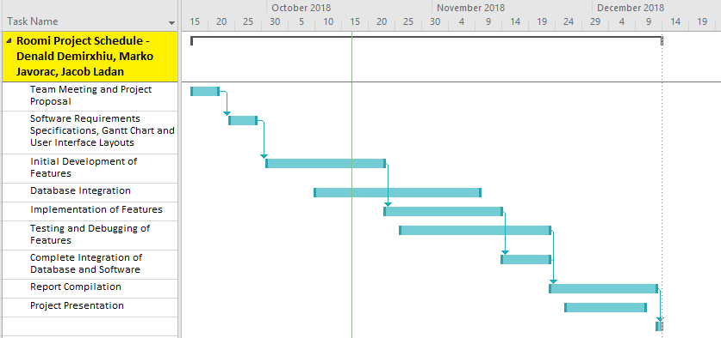
Schedule

Slide 4
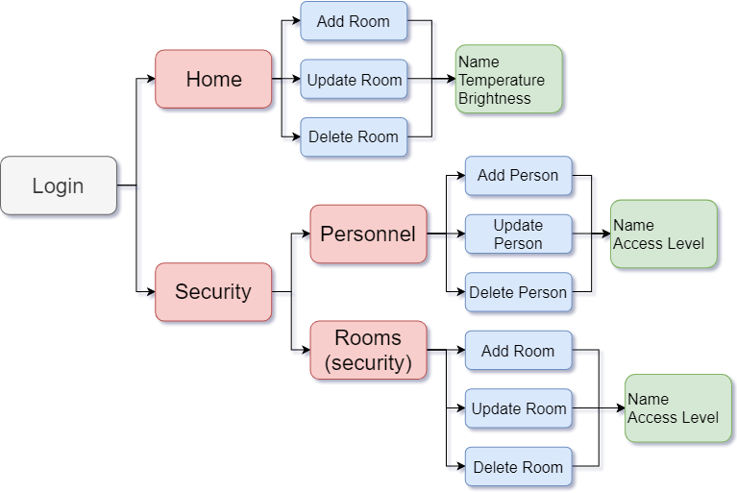
Flow Diagram

Slide 5
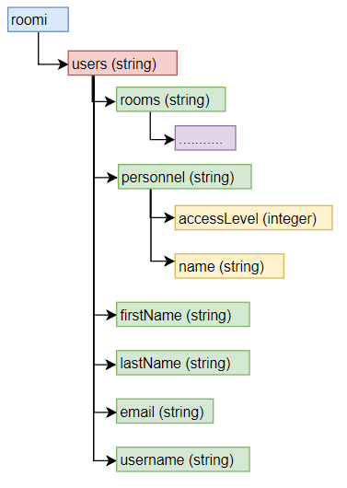
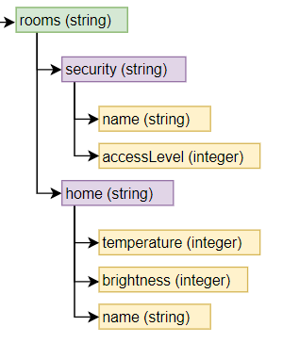
Database Design

Slide 6
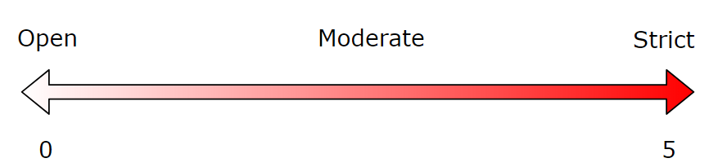
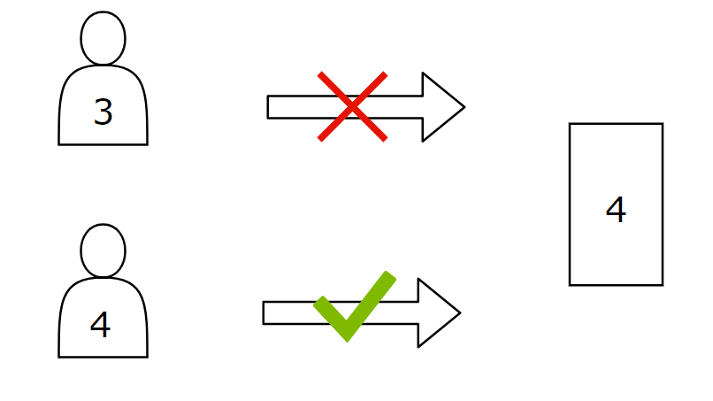
Access Level Explained

Slide 7

Application Demo

Slide 8
Testing: Case #1
Email/Password Validation
Purpose: Checking that the information entered is valid
Precondition: Entering fields in either the login or register page.
Test Procedures: The email entered must be in the standard email format. Checking that the entered password includes more than 6 characters.
Expected Results: If the data is valid, users will be able to access the application.

Slide 9
Testing: Case #2
Email Already In Use
Purpose: Checking if the email is already in the database
Precondition: Creating new user
Test Procedures: The email entered must not already be used by a registered user.
Expected Results: The application will not allow users to register. You will be notified that the email is already in use.

Slide 10

Acquired Knowledge
Android Development
Github - Version Control
Teamwork
Documentation
Firebase

Slide 11
Challenges Faced
Collaborative Work
Authenticating Users
Dynamically Generating Views
rm -r everything

Slide 12
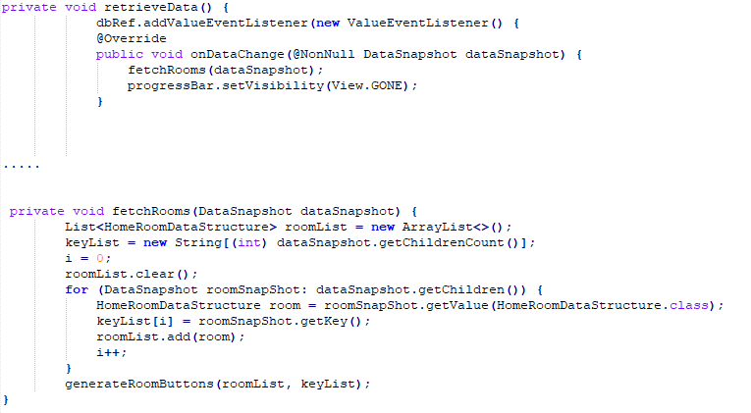
Challenges Faced - Dynamic Elements

Slide 13

What’s next?
Hardware Integration
Case Design/Prototype
Software Refinement
Account Management

Slide 14

Questions

